Slide 1

CHƯƠNG TRÌNH ĐÀO TẠO NHÂN VIÊN
MÔN HỌC: CSS
Object-Oriented CSS
Trình bày: Team 5
HANOI – JUN, 2015
6/18/15
www.qsoftvietnam.com
<number>
Notes:
<number>

Slide 2
What is object-oriented CSS?
A methodology of writing reusable CSS that is fast, scalable and maintainable.

Slide 3
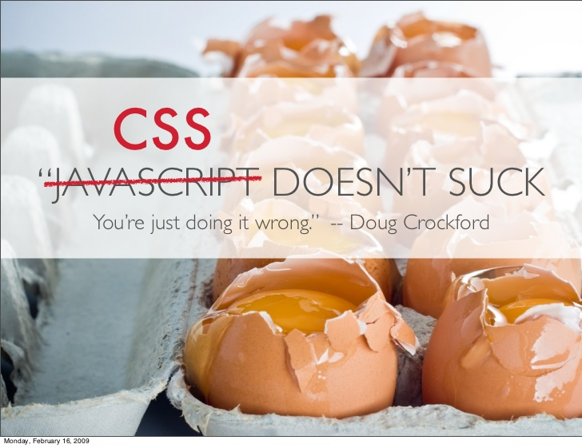

Slide 4
CODE RE-USE IS ALMOST NONEXISTENT
people don’t trust other developers code

Slide 5

Anything re-usable?

Slide 6
OVERRIDING IS VERY COMPLEX
Almost my css lines of code is overridden

Slide 7
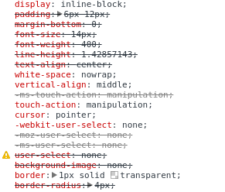

Slide 8
FILE SIZE JUST KEEPS GETTING BIGGER
As the site evolves we continuously modify the CSS

Slide 9
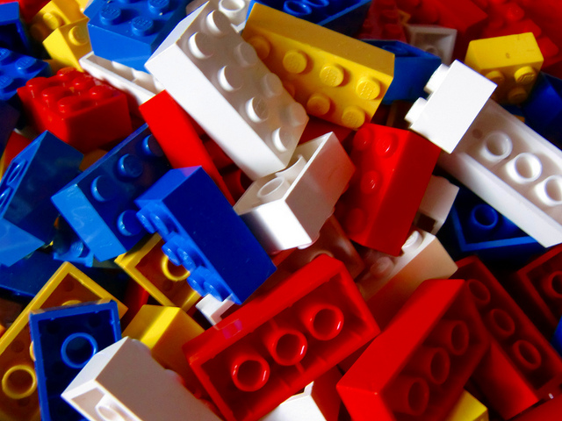

SOLUTION
Object Oriented CSS

Slide 10
TWO MAIN PRINCIPLE
1. Separate Structure and Skin
2. Separate Container and Content

Slide 11
SEPARATE STRUCTURE AND SKIN
Separating positioning (position, float, margin, etc.) from styling (background, color, border, etc.)

Slide 12
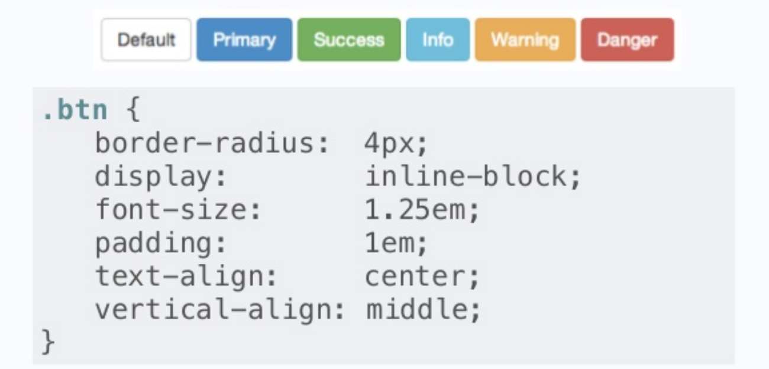

Slide 13
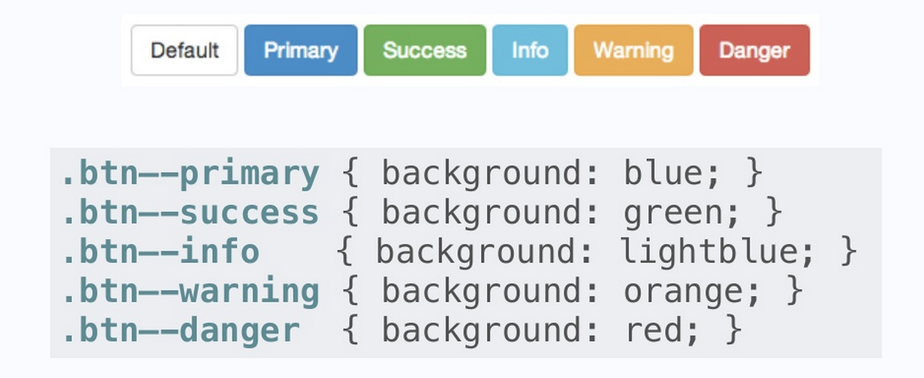

Slide 14
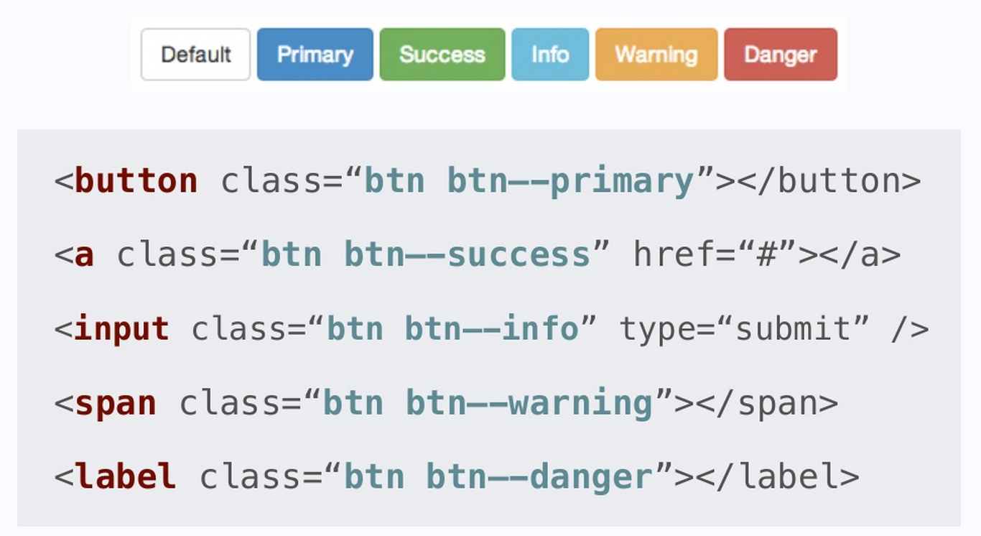

Slide 15
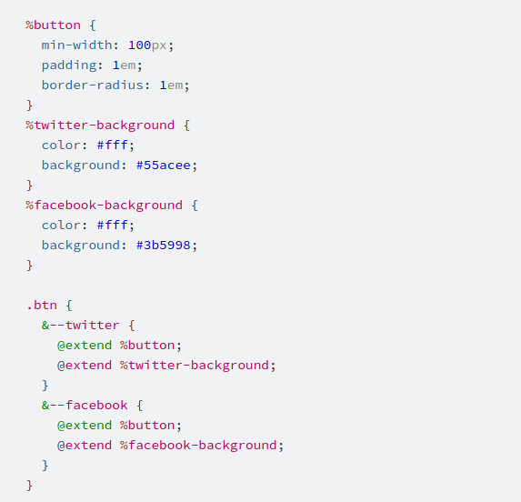
SASS WAY

Slide 16
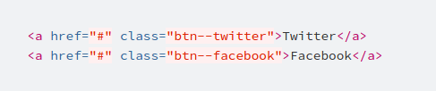
SASS WAY

Slide 17
SEPARATE CONTAINER AND CONTENT
Objects should look the same
no matter where you put them

Slide 18
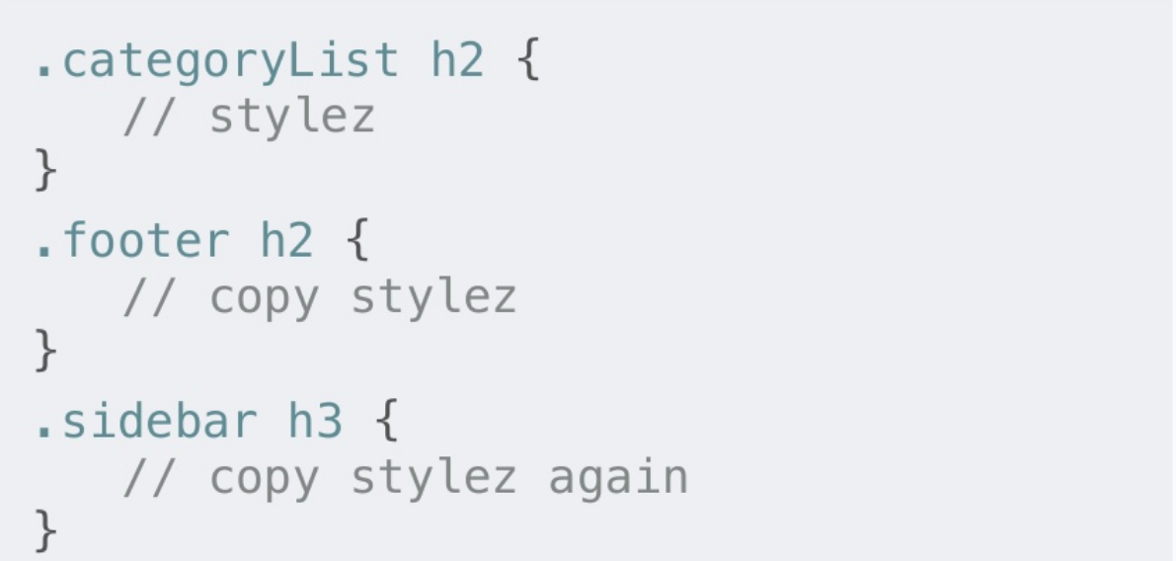
BAD

Slide 19
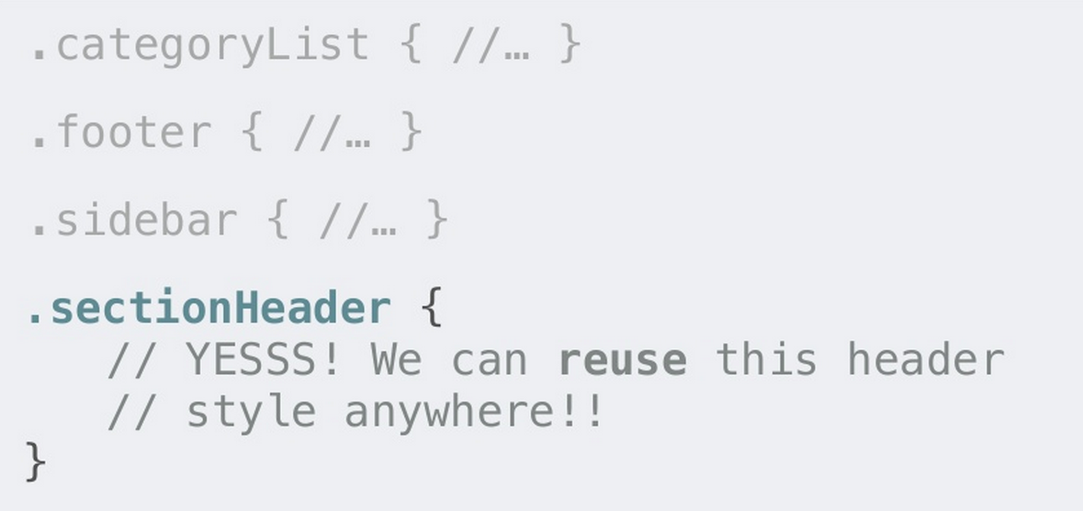
THE RIGHT WAY

Slide 20

h1.page-title h1 .title-underline
.newsletter-block .block .block-gray
.newsletter-subscribe .btn .btn-orange
.recent-post-block .block
aside h3 h3
aside ul .white-list
aside ul li .white-list-item
aside ul li.highlight
.white-list-item .white-list-item-highlight

Slide 21
IMPORTANT NOTES
Avoid styling ID selectors
Avoid attaching class to element selectors, ie. a.sub-title
Avoid styling descendent selectors, ie. .sidebar .recen-post ul li
Avoid !important

Slide 22
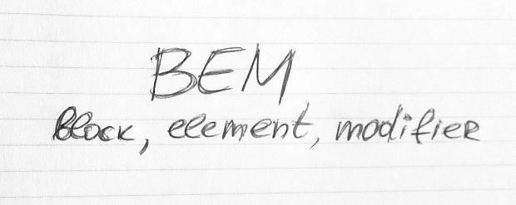
YOU SHOULD READ

Slide 23
THANKS FOR YOUR ATTENTION

